Slide 1
V-Cycle Pro Virtual Bike Simulator ENSC 440/305-Spring 2010 Project Flashback © Lukas-Karim Merhi
Jan 11th , 2017
Notes:
Hi everyone,
Thanks Steve for hosting me today and giving me an opportunity to share my past experiences/project with 440 and also being a past TA for this course.
I took this course all the way back in spring 2010 where we also had the challenge of balancing school work with the Olympics. FUN TIMES!
How many people own bikes here? Hands up folks
How many of you that go to the gym use the stationary bike exercise machine?
Looking around us we found that all current biking simulators either at the gym or at home were seriously boring exercise machines, in most instances no visual feedback, were not real bikes and quite stationary!
One of our team mates, Dan, an avid cyclist was always complaining about that so we decided lets change this around
Our company was called V-Cycle and the product we developed was termend V-Cycle Pro a virtual bike simulator but with a twist!

Slide 2
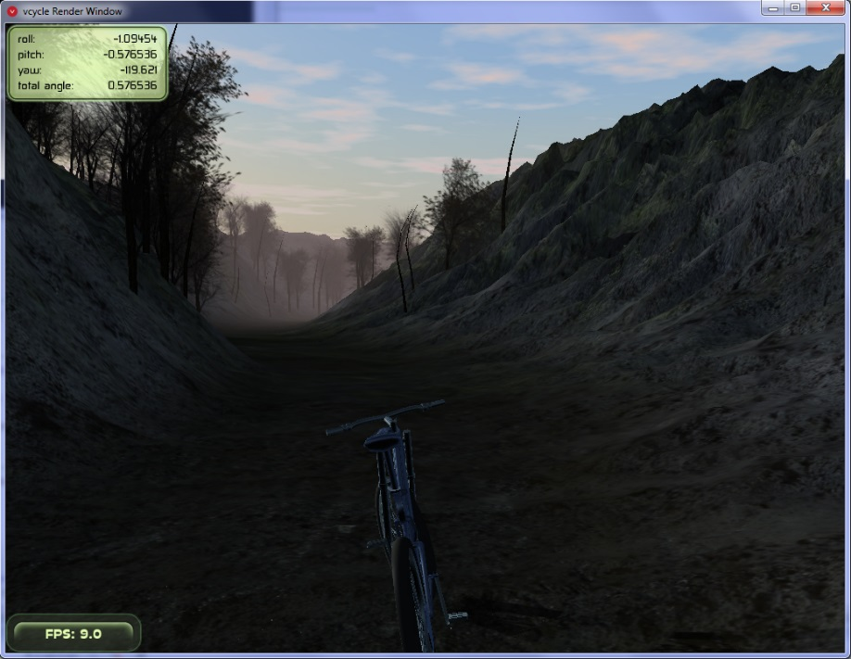
Objectives
Background – Goals
Using your own bike indoors to enjoy a realistic cycling experience | Achieved
Simulate terrain, elevation and resistance. | Achieved
Tilting and turning capabilities | Achieved
Notes:
So we went ahead and set out our objectives for the project
So what we came up with was a multi-platform solution

Slide 3
Our Solution
Background – V-cycle
Make videos!
Notes:
So here state:
Front platform is used for elevation terrain, receives input from our video game for height adjustments
Back platform records the wheels turning and sends that info back to our video game
Back platform records distance covered and tilting of the bike and also sends that data back to the video game!
And is also used for resistance simulation

Slide 4
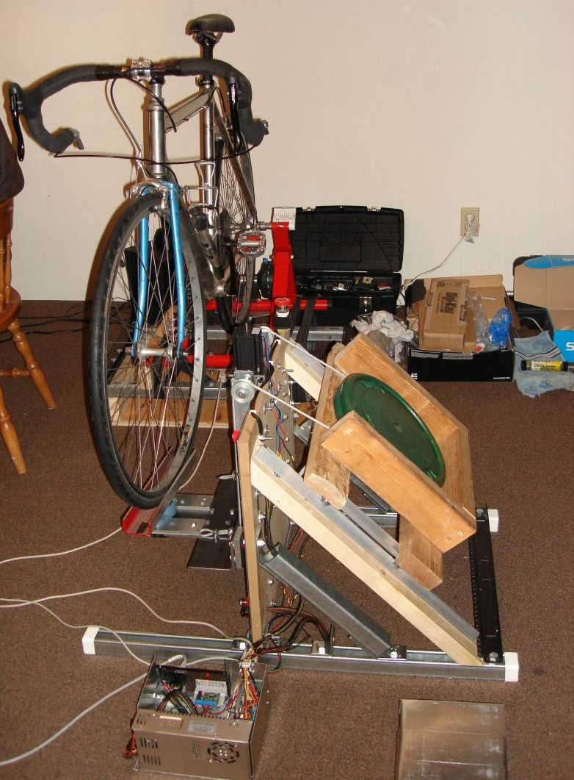
Product Design
Product Design

Slide 5
Front and Back Platforms
Product Design – Structural
Simulate your design!
Use Google Sketchup - Free
Notes:
Solid works is great tool, don’t know it, learn it and it will be a very handy tool throughout your engineering careers I mean even when you are done with school

Slide 6
Tilting Mechanism
Product Design – Mechanical
The solution already exists and will probably be simple!
Notes:
We used skateboard rubber bushings and used bicycle rubber tubes !

Slide 7
Gravity Assist
Product Design – Mechanical
Known Fact: Gravity is omnipresent!
Notes:
You can’t escape gravity ever! So keep that in mind

Slide 8
Electronics Systems
Product Design – Electronics
Notes:
So this was our high level diagram
Next are a few general lesion the team and I learned the hard way and actually have seen many groups fall in the same trap

Slide 9
Lesson 1:
Do not be lazy: try to read as much documentation of your components as possible
Read the RUBRIC that Steve shares with you

Slide 10
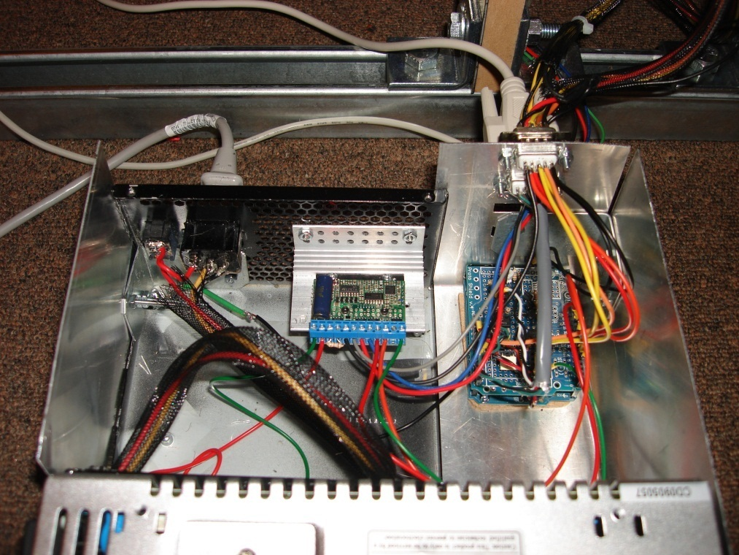
Lesson 2: Safety Design
Product Design – Safety
Electronics enclosed in a grounded box
Fuse protection on power components
Insulated wiring and warning signs
Notes:
We lost our $240 motor controller about a week before the demo, I am partially to blame for that, there was a lose cable and our box wasn't grounded and we hadn’t incorporated a fuse so boom, the thing just exploded!
Power supply
Microcontroller
Sensors
Motor driver

Slide 11
Lesson 3: Modular Design
Product Design – Usability
Stand Alone Mode (no software)
Active Mode (software interface)
Tilting can be mechanically disabled
Modular Design
3 main components (back and front platform, control box)
Set of cables (2 serial, 1 USB, 1 Power)
Easily disassembled

Slide 12
Lesson 4: Sustainability
Product Design – Sustainability
Use of recycled materials
Scrap wood
Scrap metal
Left over fasteners
Old popped bike tubes
Reused electronic components

Slide 13
Lessons from the group members
Dan: My best lesson learned is to design all systems for testability. We always gave and accepted honest and critical feedback between ourselves on design decisions, never fighting because we recognized that open and honest communication would build trust in the group and result in a better overall product.
Jack
More planning also should have been given to acquiring proper tools for metal working, especially a drill press
Lukas: Arduino microcontroller: it turned out to be a great development tool especially with its open source platform, multiple analog and digital pins, serial communication, and headers for attaching custom made prototyping boards. I learned to always ask if I didn’t understand something and that making mistakes are essential to any learning experience.
Mike I have seen a few 440 demos and was always disappointed. It seems that students work for hundreds of hours on their projects and then demo in a room with a couple friends, the instructors and a closed door. It seemed depressing to me that you can spend 5 years of your life in an engineering program, and no one cares what you have accomplished at the end of it.

Slide 14
Questions?
Questions
Good Luck!
Notes:
Mike

Slide 15
What would I have done if I had 2 semesters?
Questions
Solving a pain (want to sell chemotherapy and not vitamins)
Getting out of the building and validating your idea (every team members speak to at least 5 people)
Create a mock-up + <1 minute survey – go back to your contacts and receive feedback
Notes:
Mike

Slide 16
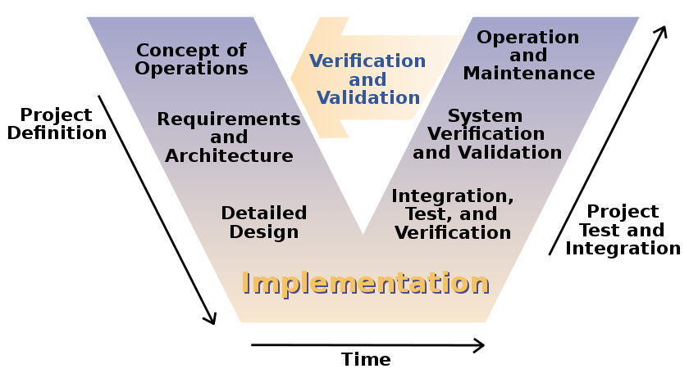
What would I have done if I had 2 semesters?
Questions
Customer Needs
Establish Requirements to meet those Needs
Bookkeeping, accounting, financials
Join an Incubator
Notes:
What will they be using your device for?
Accelerators programs usually have a set timeframe in which individual companies spend anywhere from a few weeks to a few months working with a group of mentors to build out their business and avoid problems along the way. Y Combinator, Techstars, and the Brandery are some of the most well-known accelerators.
Incubators
Startup incubators begin with companies that may be earlier in the process and they do not operate on a set schedule. If an accelerator is a greenhouse for young plants to get the optimal conditions to grow, an incubator matches quality seeds with the best soil for sprouting and growth.
While there are some independent incubators, they can also be sponsored or run by VC firms, government entities, and major corporations, among others. Some incubators have an application process, but others only work with companies and ideas that they come in contact with through trusted partners. A good example of an incubator is Idealab.

Slide 17
Final Words
In the last few weeks of the semester, live a little beyond your project. Take a break. Go out for dinner, go to a movie, have a beer, have a pop, take a walk, take a hike, and ski back down. Project courses can steal your life. Steal a few hours back.

Slide 18
SHOPSMART | Capstone 2015

Slide 19
Shopping Cart Concept |IDEO
http://www.youtube.com/watch?v=M66ZU2PCIcM

Slide 20
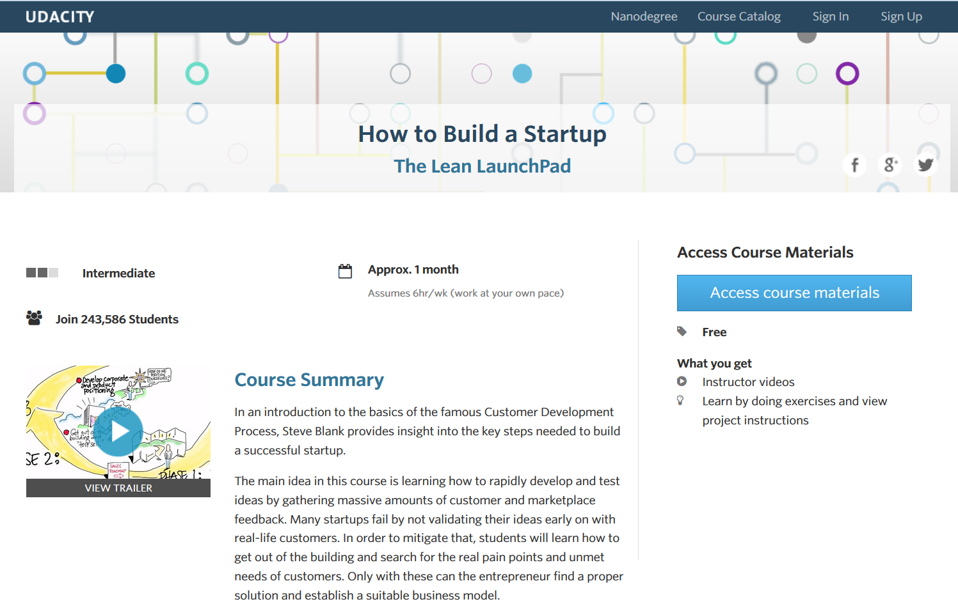
The Lean Launchpad
https://www.youtube.com/watch?v=VZvgj6B2JZs
Notes:
The lean Launchpad:
https://www.udacity.com/course/ep245
https://www.youtube.com/watch?v=VZvgj6B2JZs

Slide 21
Ted Talk
Richard St. John: Secrets of success in 8 words, 3 minutes
http://www.youtube.com/watch?v=Y6bbMQXQ180

Slide 22
Project Costs
High Level Details – Costs
 | Realized ($) | Budgeted ($)
Electronics Components | 479.02 | 465.00
Sensors and analog circuitry | 234.02 | 130.00
Digital circuitry | 245.00 | 335.00
Electro-Mechanical Components | 990.88 | 630.00
Structural (Metals, struts, wood, fasteners) | 409.52 | 100.00
Mechanical (Ball screw, linear actuators, motor, power supply, generator) | 376.69 | 380.00
Bike trainer | 204.67 | 150.00
Total | 1469.90 | 1095.00
Notes:
Lukas
Outline of the major expenses

Slide 23
Teamwork
High Level Details – Teamwork
 |  | Dan | Mike | Lukas | Jack
Design | Code and circuits | X |  | X
 | Structural and mechanical |  | X | X | X
 | Software |  |  |  | X
 | Variable resistance | X | X
Implement | Computer and MCU | X |  |  | X
 | Structural and mechanical |  | X | X | X
 | Sensors and circuitry | X |  | X
Notes:
Lukas
How we allocated the work
Teams of people worked on each section

Slide 24
Development Timeline
High Level Details – Time Management
Item | Proposed | Implemented
Order parts | February 3 | Ongoing
Sensors | February 5 | March 9
Front lift platform | February 19 | April 1
Resistance electronics | February 23 | Not implemented
Tilting system | February 26 | March 1
Stepper code | March 6 | April 14
Resistance mechanical | March 12 | Not implemented
1D acceleration | March 23 | March 22
Notes:
Lukas
May have to simplify this if it doesn’t show well on projector
Discussion of proposed vs. actual milestones

